Slide 1
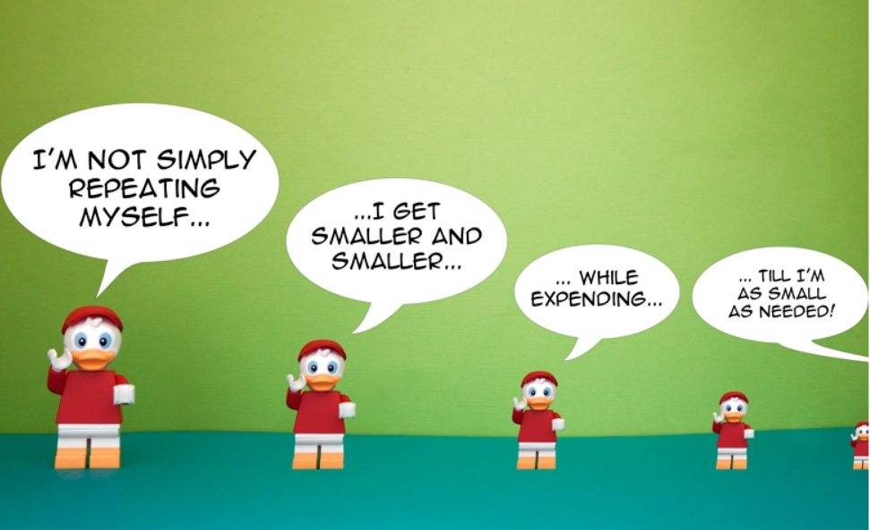
Recursion
recursion is a useful skill to have. ^__^

Slide 2
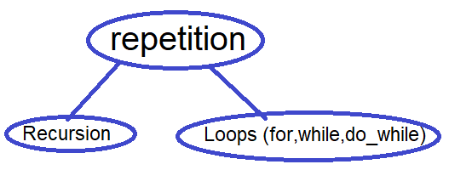
About Recursion
Recursion: is type of repetition like a loops.
Of course, each type has advantages over the other.
Recursion: it is a function calls itself automatically inside its scope, until reach to a certain condition, that stop this calls,
It is used approach breaking a problem down into smaller and smaller subproblems until you get to a small enough problem that it can be solved trivially.
Also Recursion it is called a recursive thinking.

Slide 3
What is a prerequisites for Learn a recursion?
1- Function
2- Loops (to easy learn a Recursion & I will used it inside a Recursion).
3- Overview Stack.
What will I gain if I learn Recursion?
1) Firstly,
As a basically, recursive thinking is important for any programmer.
2) it is a base for some topics like
BackTracking (technic in recg)
Dynamic Programming(optimization for recg)
Graph
And more…

Slide 4
What is the first appearance for Recursion? Is in Programming?🤔
No, the first appearance for Recursion was Math.
Examples:
(a) If I want factorial 3?
3! = 3 * 2 * 1 >> = 6 but we will ignore this
or formula
n! = n * (n – 1)!
3!= 3 * (2!)
So we need (2!)
!2 = 2 * (1!)
so we need (1!) and factorial for 1 and 0 is 1 as a mathematically.
So we will use what we got in order to get the answer to our question.
(1!) = 1
(2!) = 2 * (1! >> 1) >> = 2
(3!) = 3 * (2! >> 2) >> = 6

Slide 5
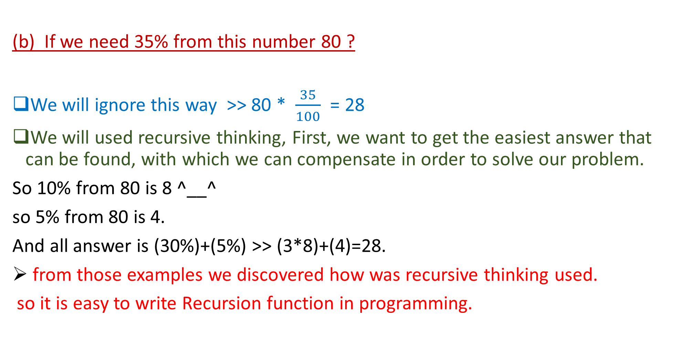
(b) If we need 35% from this number 80 ?
We will ignore this way >> 80 * $\frac{35}{100}$ = 28
We will used recursive thinking, First, we want to get the easiest answer that can be found, with which we can compensate in order to solve our problem.
So 10% from 80 is 8 ^__^
so 5% from 80 is 4.
And all answer is (30%)+(5%) >> (3*8)+(4)=28.
from those examples we discovered how was recursive thinking used.
so it is easy to write Recursion function in programming.

Slide 6
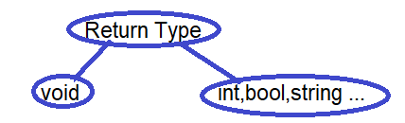
What are the main parts in recursion function?
1- Return type for function >> what is return function
2- base case >> what is condition that stop recursive call
3- statement >> what I want, it may not exist
4- recursive call >> repetition break problem into smaller
So code will be
Return_type name_of_function (parameters or named (state لان كل مره بتتولد فانكشن جديده))
{
//condition for base case
//statement (sometimes didn’t)
//recursive call
}

Slide 7
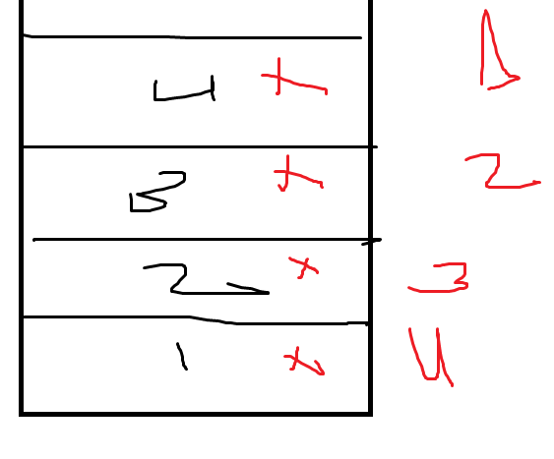
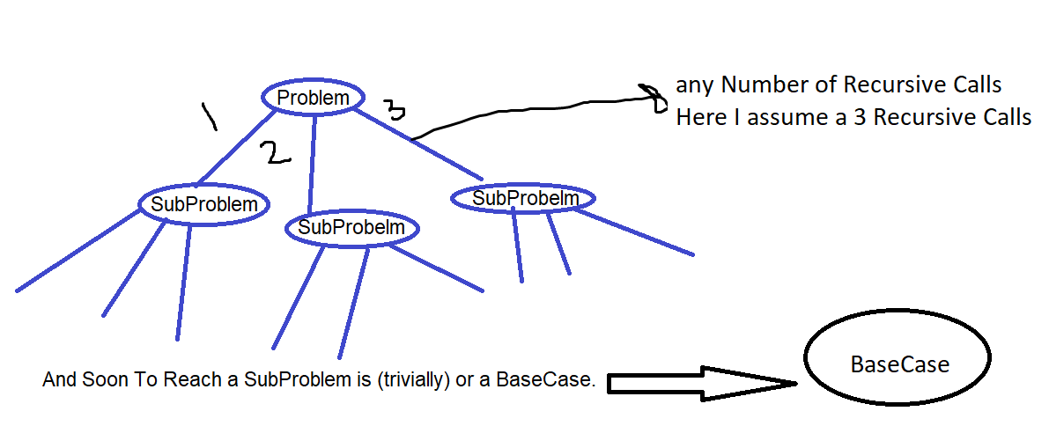
Overview stack:
Overview tree in recursion :
رسم شجره ليها تفرعات تستخدم لتسهيل
الوصول للحل باستخدم الريكرجن
الرسمه ده بتكون لنفس مفهوم
الاستاك ف الجهاز

Slide 8

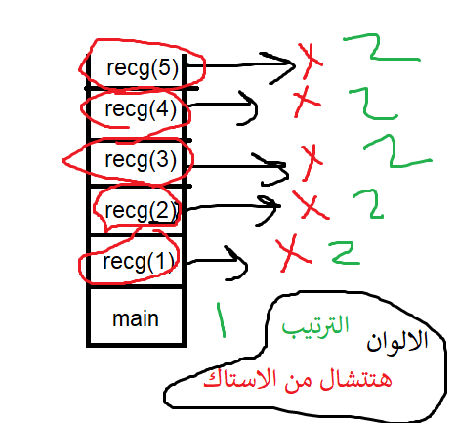
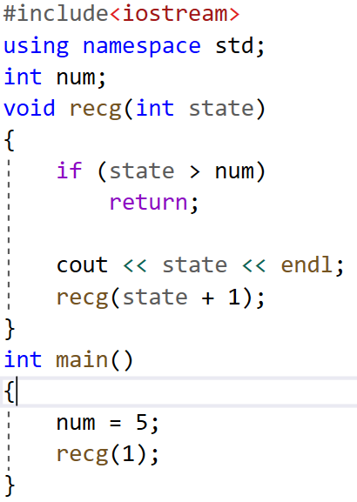
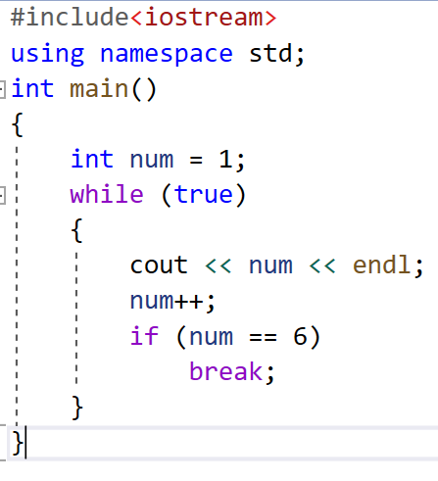
What different between loops and recursion in Syntax?
Example (not void return): print number from 1 to 5
By loops By recursion
The outputs will same for two code

Slide 9
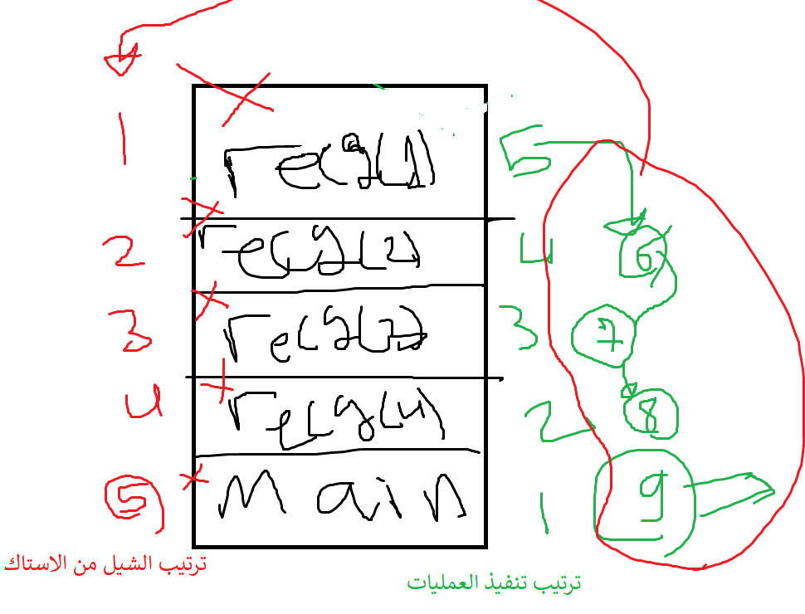
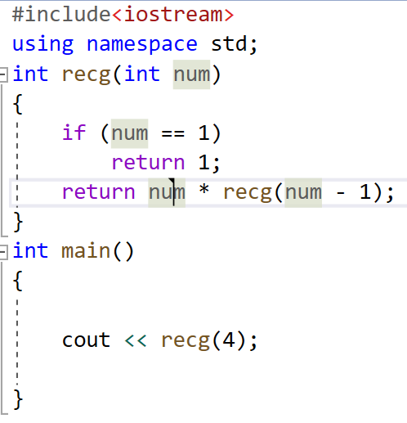
Example (void return): print factorial for 4

Slide 10
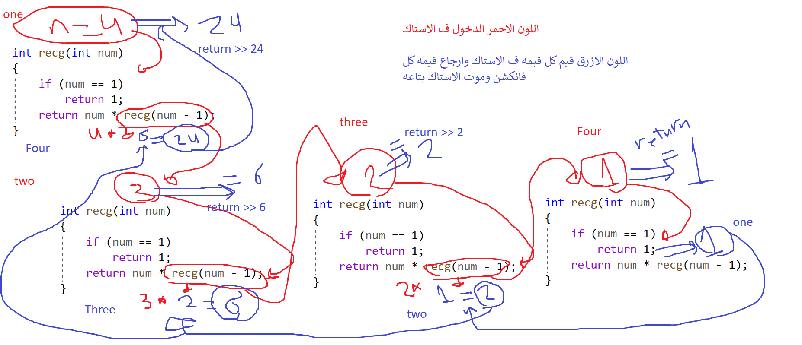

Slide 11
Task
Print summation from 1 to N by Recg

Slide 12
Thank You.
By: Mohamed Abdelmoniem
LinkedIn:
https://www.linkedin.com/in/mohamed-abd-elmoniem-6b14851a3/

